Slide 1
Special Effects Presentation Particle Systems: Smoke
Team LORT
March 4 2015

Slide 2
Task Allocation
 | Task
Sam | Research PArray
Gary | Research Super Spray, PFlow Super Spray comparison
Justin | Research forces affecting particle systems (eg. wind)
Sasha | Research Particle Flow (PFlow)
All | Create presentation

Slide 3
Question
Is one method for generating smoke special effects “better” than the others?
Objects to consider:
Super Spray
PF Source (PFlow)
P Array (PBomb)

Slide 4
Answer
That depends on what your requirements are!
Less time to learn:
Super Spray
Customizability:
PFlow
Explosion effects:
PBomb

Slide 5
PFlow: Introduction
PFlow, also known as Particle Flow. Use Particle Flow Source (PF Source) object.
Pros
Lots of customizable features
Cons
Many features makes it more complicated to learn

Slide 6
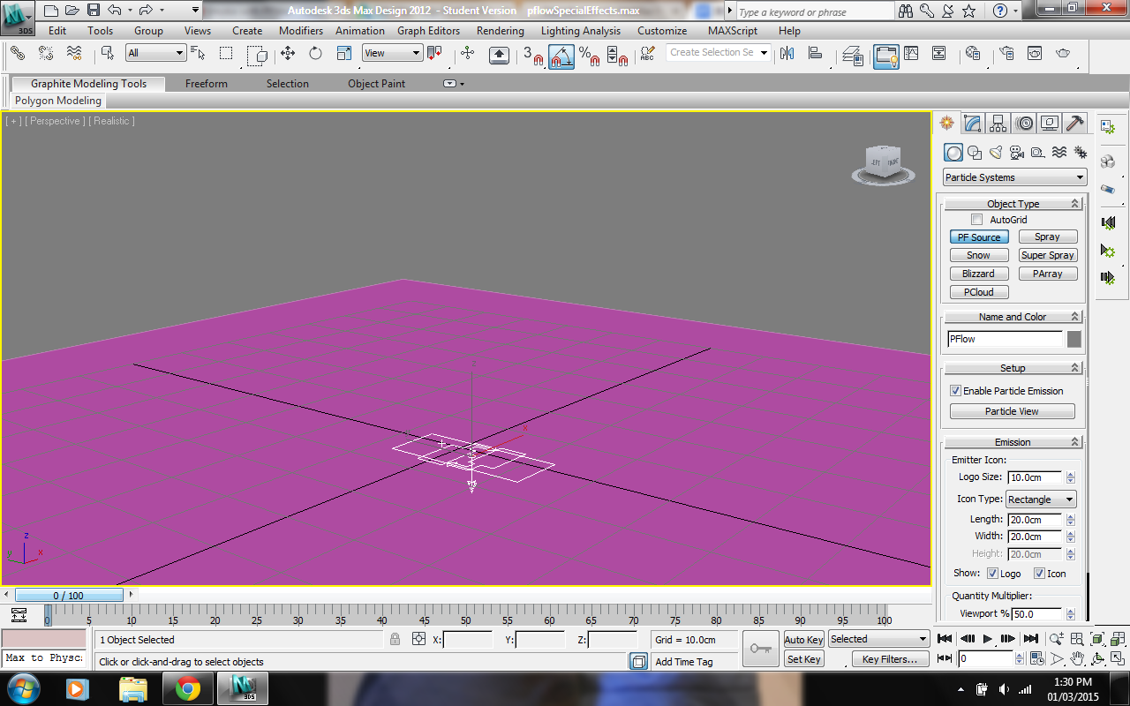
PFlow: Create PF Source Object

Slide 7
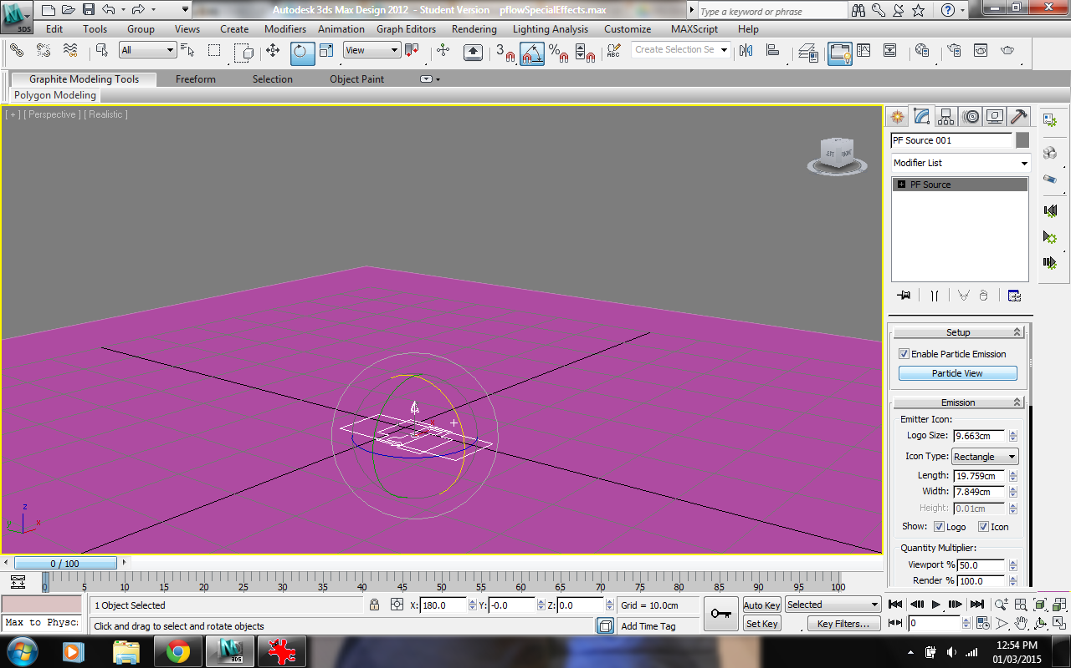
PFlow: Open Particle View

Slide 8
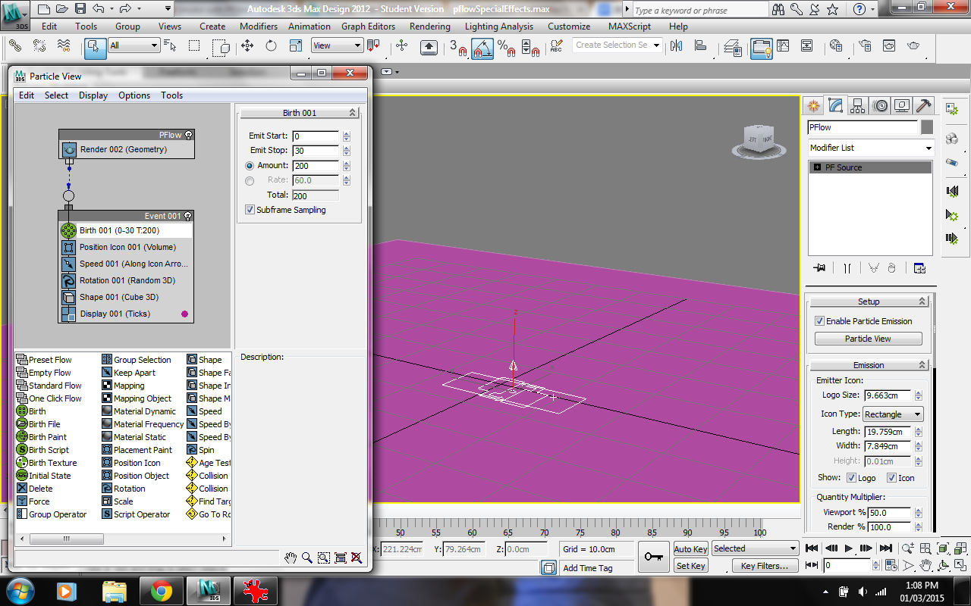
PFlow: Particle View

Slide 9
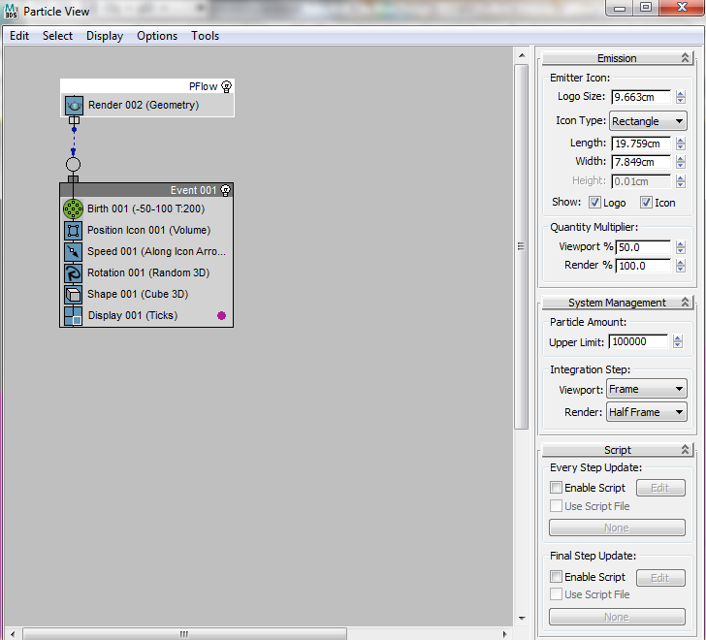
Pflow: Sidebar
Notes:
Emission: Options for the emitter object (size, emitter look, particle look in viewport)
System Management:

Slide 10
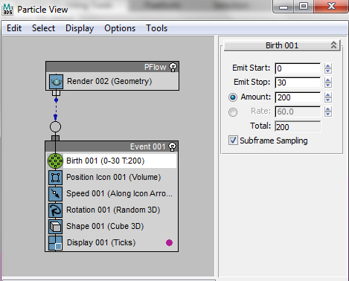
PFlow: Birth
Notes:
Emit start/stop: Frame # for start and end of flow
Amount: Number of particles

Slide 11
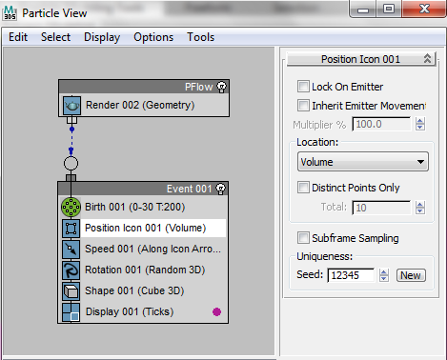
PFlow: Position Icon
Notes:
Can change the initial placement of particles on the emitter

Slide 12
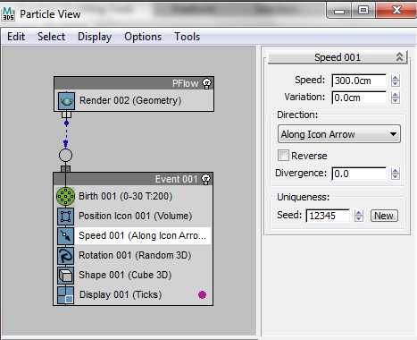
PFlow: Speed
Notes:
Allows the changing of the speed of the particles
Direction changes the direction of the flow
Divergence defines how wide the spread is

Slide 13
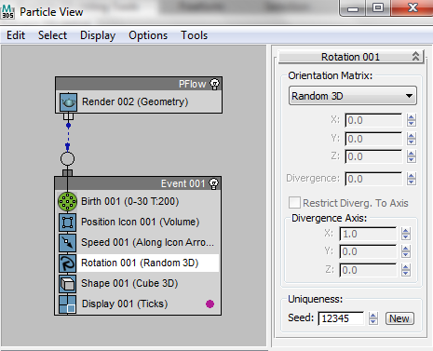
PFlow: Rotation
Notes:
Can change the axis for the flow and spread

Slide 14
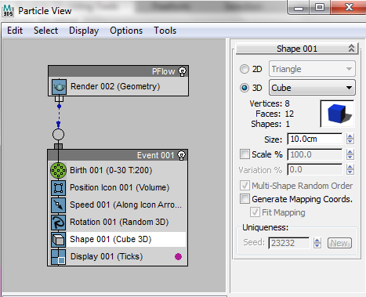
PFlow: Shape
Notes:
Allows each particles shapes to be changed

Slide 15
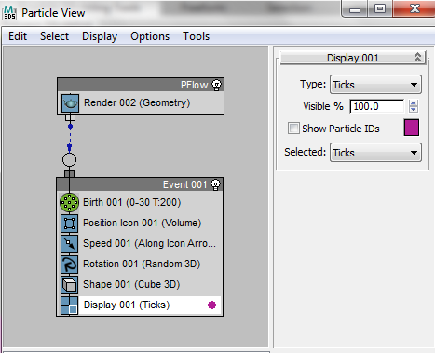
PFlow: Display
Notes:
What is displayed in the viewport

Slide 16
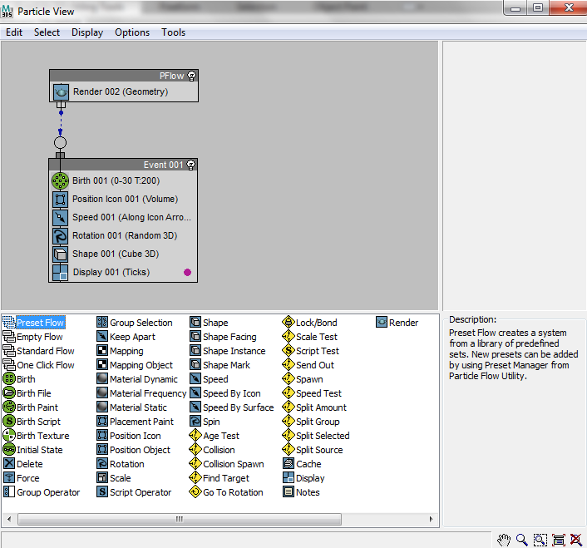
PFlow: Other Events
Notes:
Can drag the other options to the event panel to add more features
Description of each feature is available in bottom right of the window

Slide 17
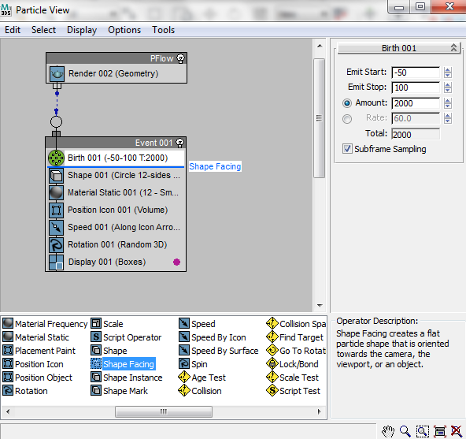
PFlow: Add Shape Facing

Slide 18
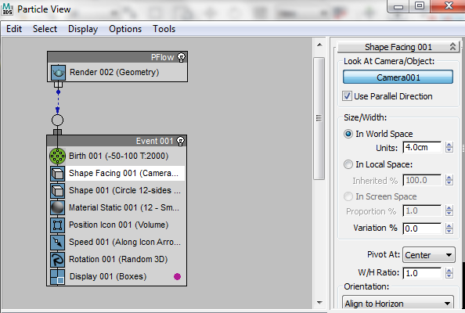
PFlow: Shape Facing

Slide 19
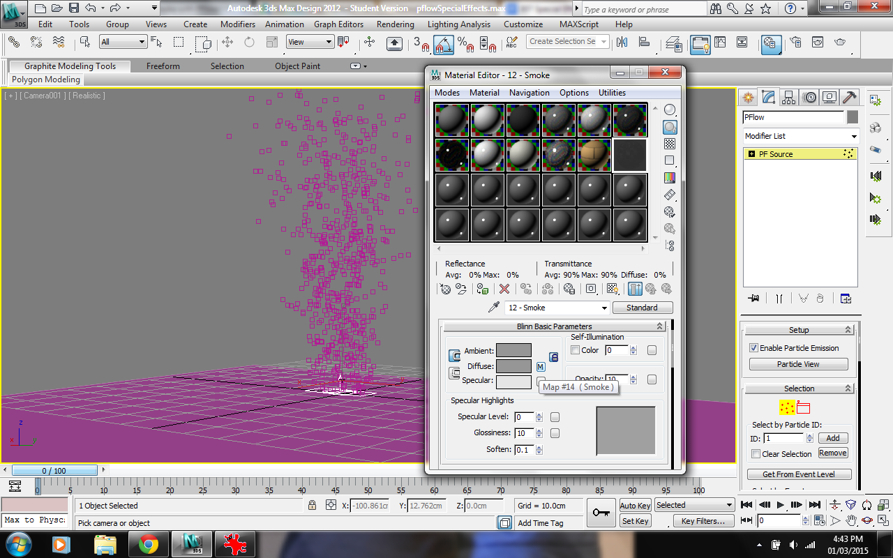
PFlow: Make Smoke Material

Slide 20
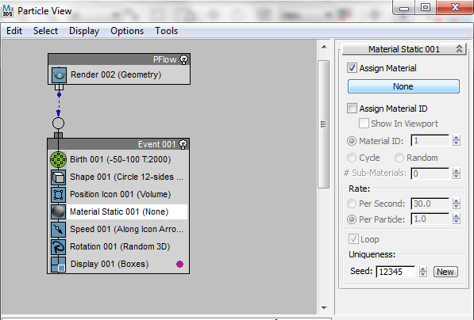
PFlow: Add Material

Slide 21
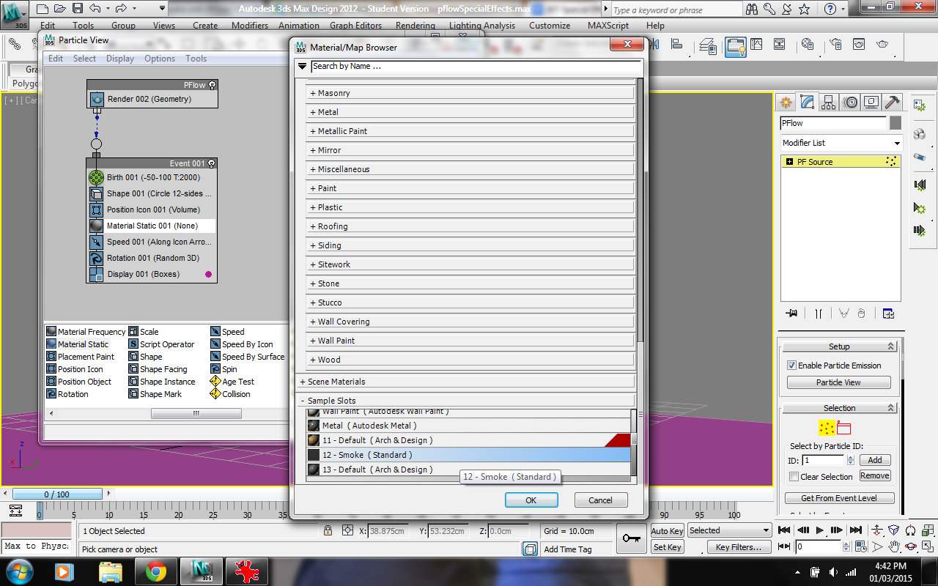
PFlow: Add Material

Slide 22
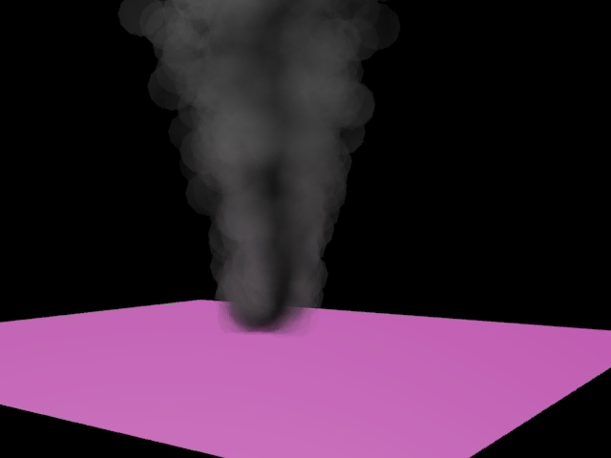
PFlow: Final Product

Slide 23
Super Spray: Introduction
If you want special effects, but don't want to manage a billion polygons yourself, use particle system!

Slide 24
Super Spray vs. PFlow
Super Spray
Easier to learn, but has less customization
Quite easy to change the orientation and spread
PFlow
Can simulate effects such as gravity, force on the particles
Can change the speed, and create collisions with other objects
Change the time it takes for the smoke to dissipate
Also contains the options that super spray utilizes

Slide 25
Super Spray vs. Spray
Super Spray
More features
Harder to learn
More powerful
Spray
Less features
Easier to learn
Lighter weight

Slide 26
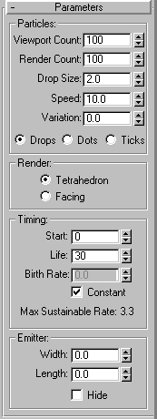
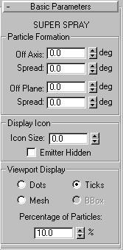
Spray Super Spray

Slide 27
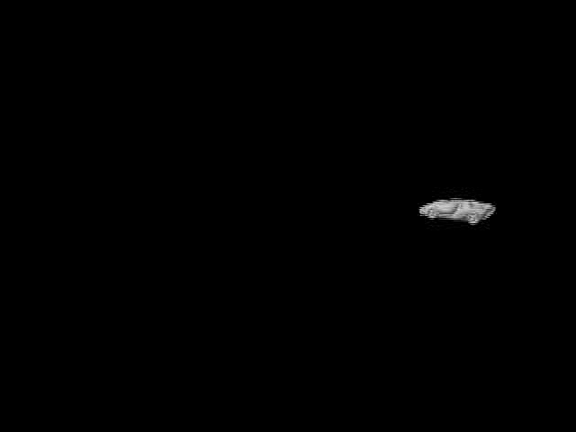
Super Spray with Forces: Damping

Slide 28
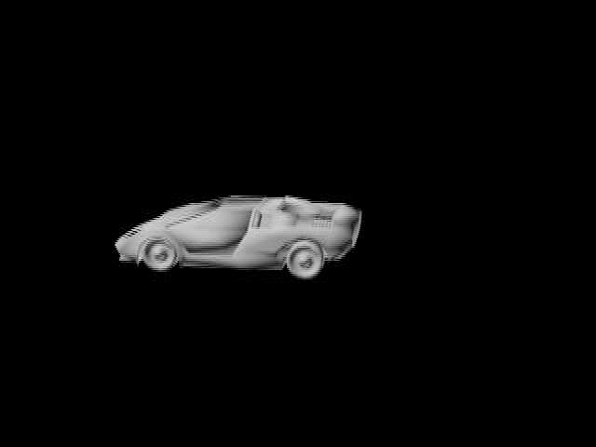
Super Spray with Forces: Damping

Slide 29
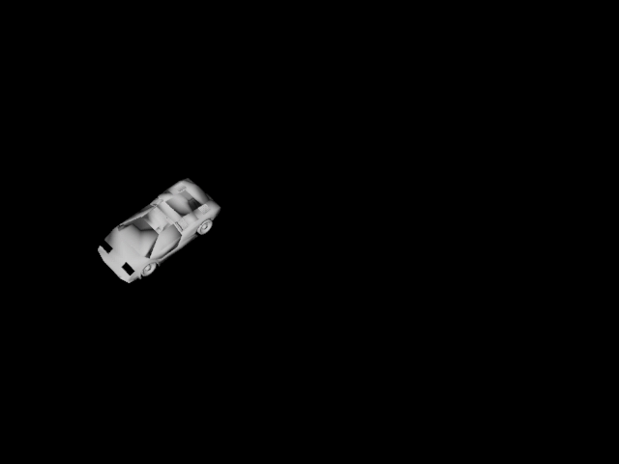
Super Spray with Forces: Wind

Slide 30
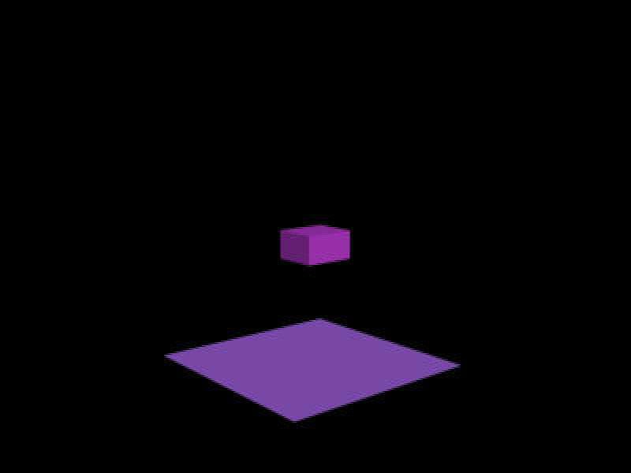
Particle Bomb (PBomb) Explosion Example

Slide 31
Pros and Cons of Particles
Pros
Don’t have to manually create each individual object
Really easy to change the flow, the orientation and the dispersion
Cons
Takes a long time to render all the objects created
The 3 examples using Super Spray are 10 seconds long and took between 30-45 minutes each to render
The example using Pflow is 1 second long and took 15 minutes to render

Slide 32
References
http://www.mrbluesummers.com/738/3d-tutorials/introduction-to-3dsmax-particles
http://makeitcg.com/3ds-max-smoke-effect/1786/
https://www.youtube.com/watch?v=dx4Tjj30kjk
http://knowledge.autodesk.com/
http://3dmax-tutorials.com/Super_Spray.html
http://3dmax-tutorials.com/Spray.html
https://www.youtube.com/watch?v=tYLQ3snrV_8

